Slide 1
L03 AI Toys
23018838 Bernice Poh

Slide 2

Play time (Eleven Labs)
Voice - Alice
Voice - Cassidy
Prompt: ‘soft medium-paced tempo of piano notes suitable as background of a presentation’

Slide 3
Activity (Eleven Labs)
Suggest how the AI-generated voice you created could enhance a presentation or talk (e.g., making it more engaging, clear, or professional).
The AI-generated voice I created could enhance a presentation with its clarity and accuracy. This would ensure a smooth flow throughout the presentation without any stutters.
Write a brief note reflecting how you may use sound effects generated by Eleven Labs in the future.
In the future I will consider using Eleven Labs to generate sound effects for background noises I might require for a video shoot
Reflect on your experience with the AI travel agent.
The AI travel agent

Slide 4
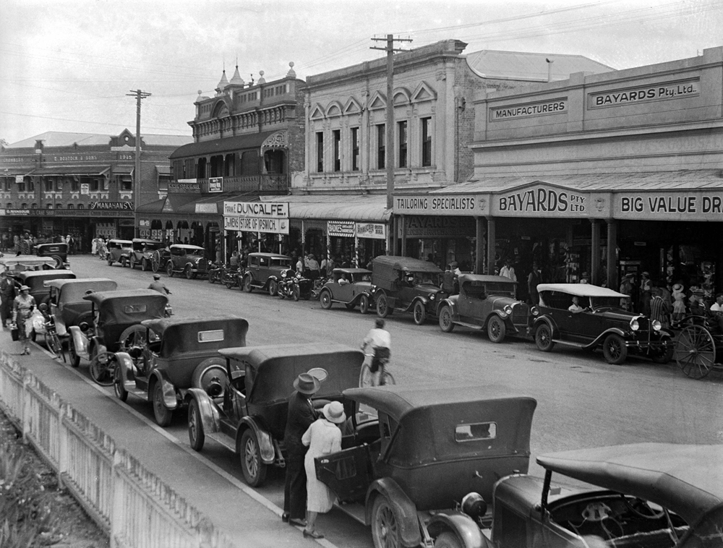
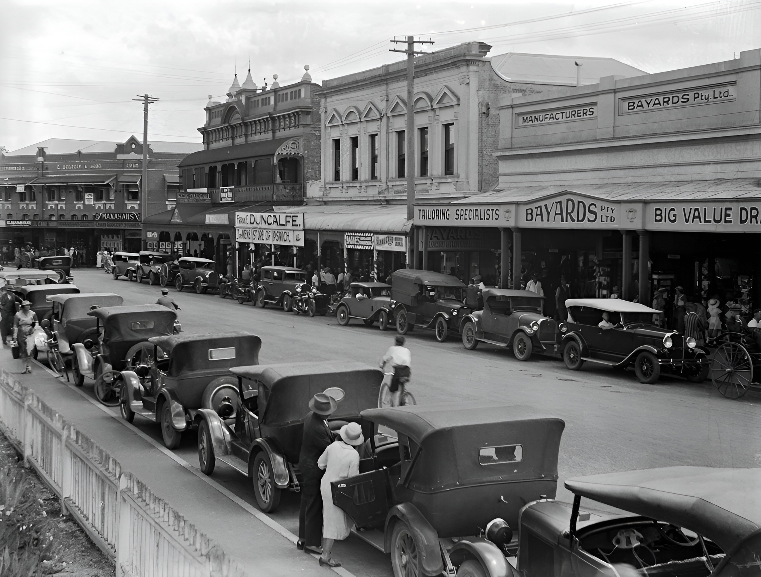
Play time (Img Upscaler)
Before:
After:
The details in the image on the right are more defined and the colour is sharper than that on the left

Slide 5
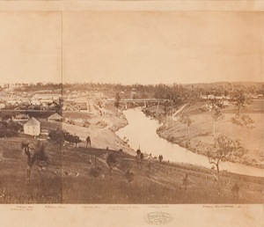
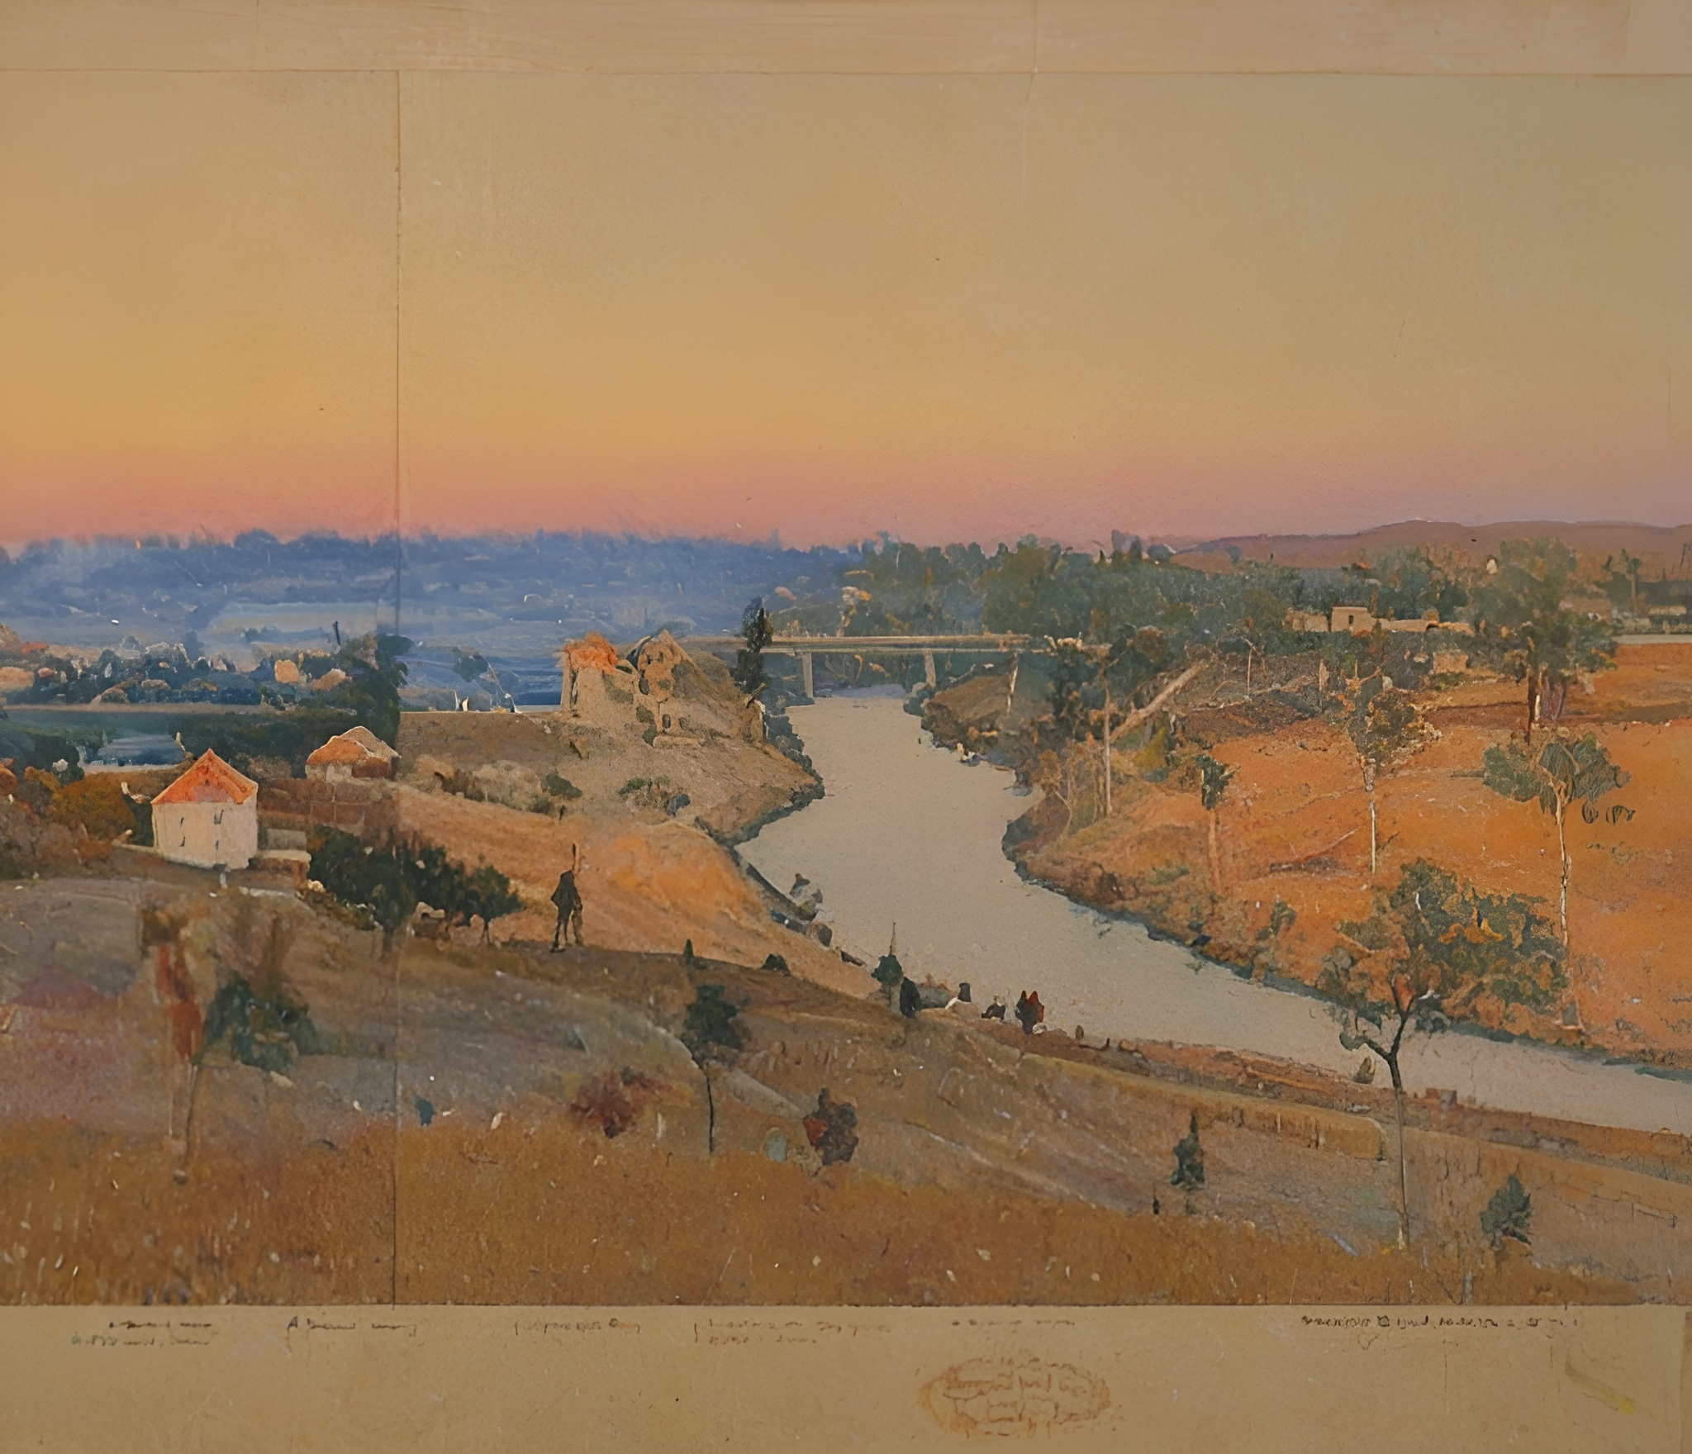
Play time (imagecolorizer)
Before:
After:
The colour has became so vibrant and easier on the eyes to capture details on the image

Slide 6
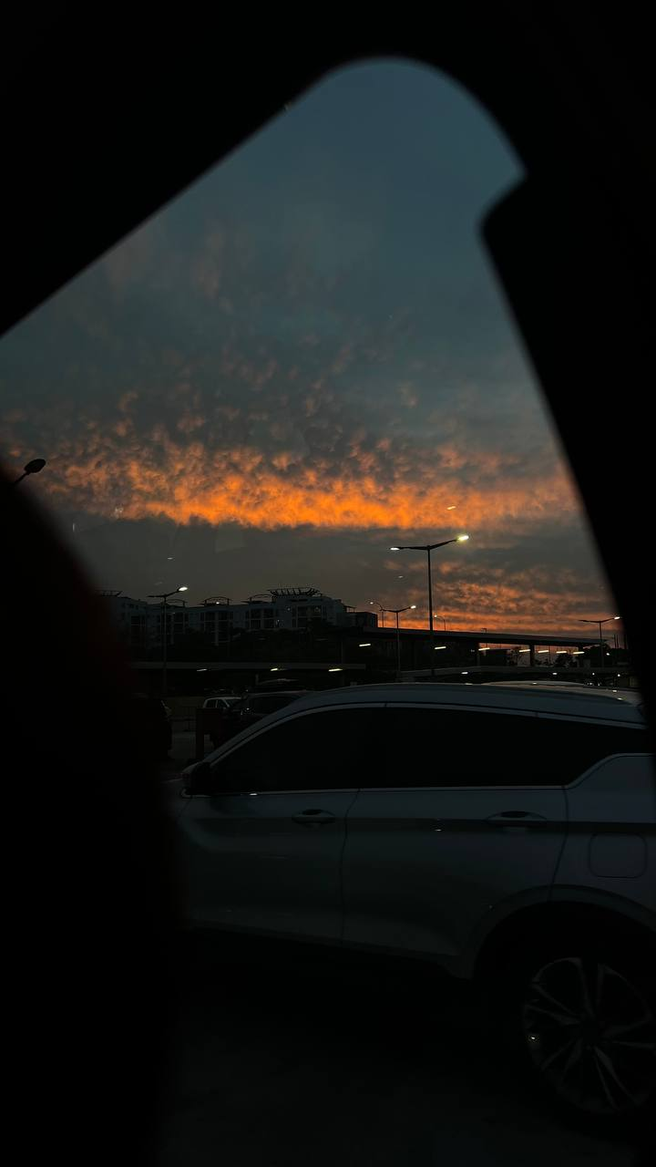
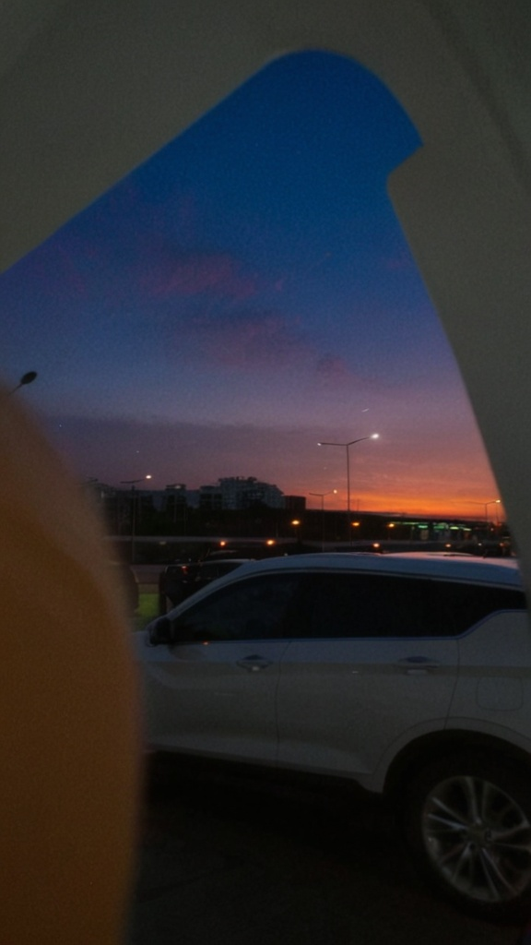
Activity (imagecolorizer)
Before:
After:
Positive prompts: brighter lightning
Negative prompts: grain, blur, dark atmosphere
Reflect on potential personal uses of this technology.
Trying to recover old pictures from my great-grandparents or pictures taken on the move which resulted it to be blur

Slide 7
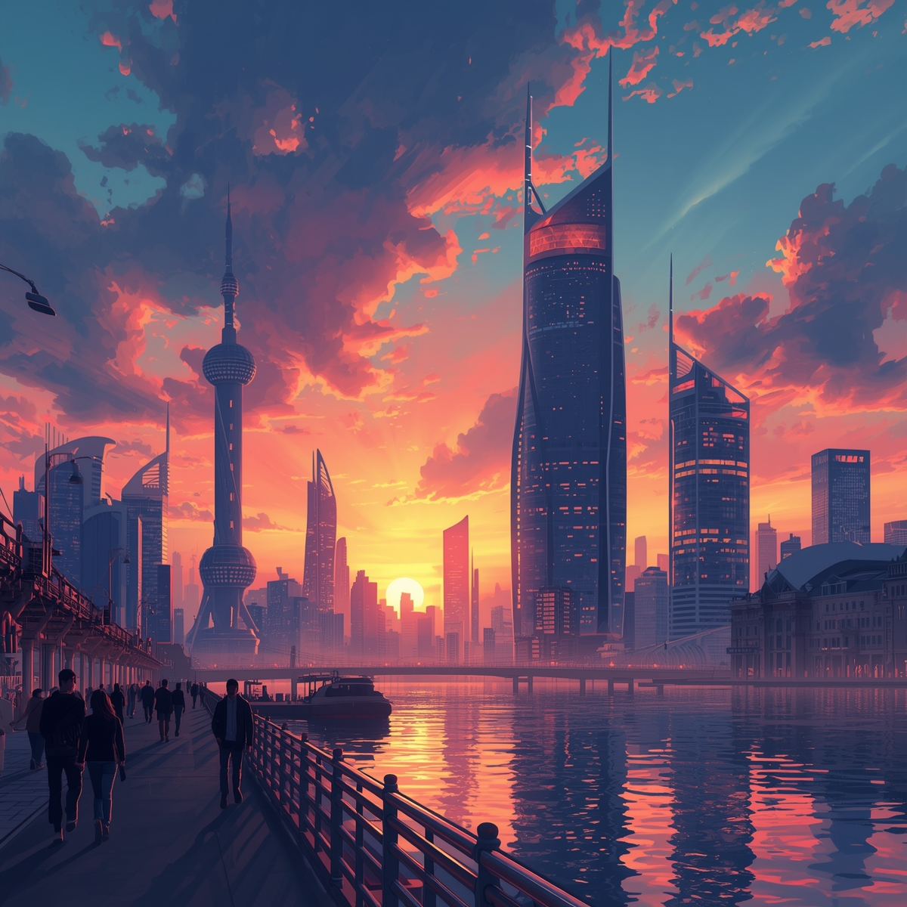
Play time (Leonardo.ai)
Prompt: Create an image using Leonardo.ai. It is to have a vibrant sunset sky, futuristic skyscrapers with glowing lights, people walking along a waterfront, and reflections shimmering on the water. The atmosphere should feel dynamic, modern, and full of creative energy

